Slide 1

Data Analysis
By ADITYA DHUMAL
HOTEL REPORT

Slide 2


Problem Statement
Hotel booking platform holds a large volume of user, review, and hotel data. This analysis
extracts insights about user behaviour, hotel performance, rating distributions, and
regional trends to improve decision-making.
Objectives
User Growth & Demographics – Track total users, yearly sign-ups, and analyze traveller
types and countries of origin.
Hotel Performance Evaluation – Measure average overall scores, staff ratings, and star-
level performance across hotels.
Customer Feedback Analysis – Assess review volumes, identify top-rated hotels, and
evaluate satisfaction by traveller type.
Geographic Insights – Identify most popular cities and countries based on reviews and
value-for-money scores.
Trend Identification – Monitor seasonal or yearly growth patterns in user registrations
and review activity.
Operational Improvement – Highlight hotels with below-average staff scores and
uncover areas requiring service enhancement.

Slide 3
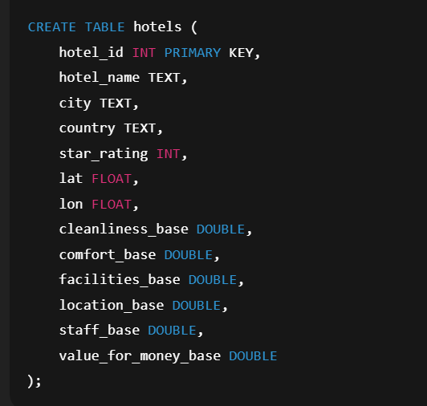
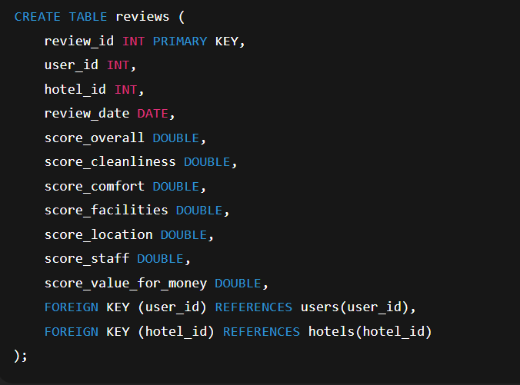
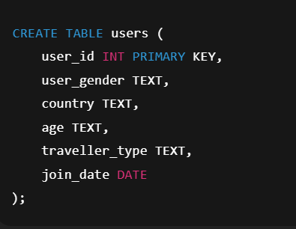
Create Table Hotels
Create Table Reviews
Create Table Users

Slide 4

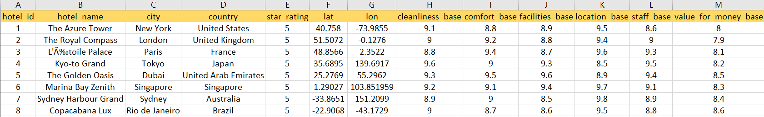
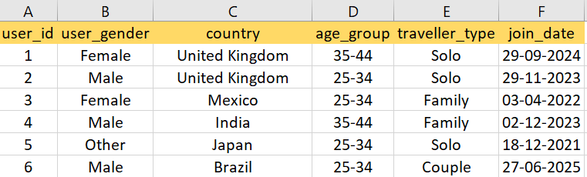
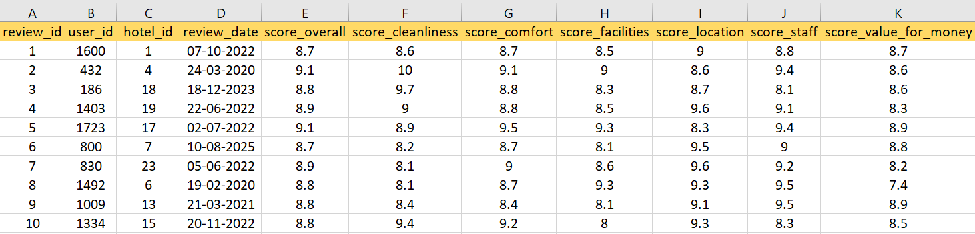
Dataset Overview
The dataset consists of hotel records, capturing details about no. of hotels , customer and customer reviews and performance metrics.
HOTEL TABLE
Total Rows = 25
USERS TABLE
Total Rows = 500
REVIEWS TABLE
Total Rows = 1000

Slide 5


SQL Queries

Slide 6
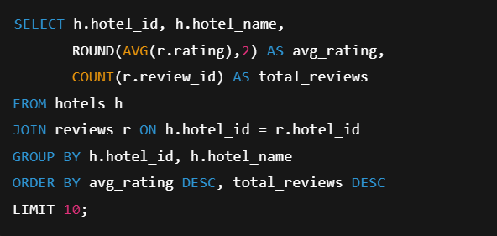
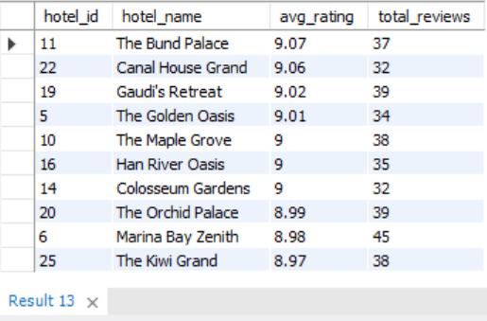
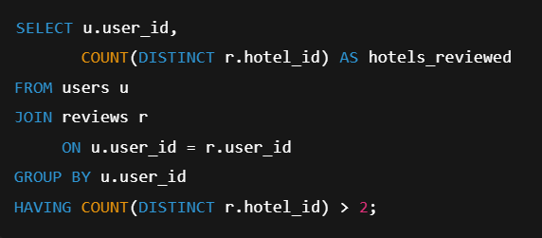
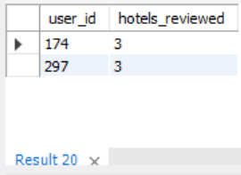
create database ola_rides;
Q1) Top 10 hotels with the highest average review rating along with the number of reviews
use ola_rides;
CREATE TABLE bengaluru_ola ( RideDate DATE, RideTime TIME,
BookingID VARCHAR(50),
BookingStatus VARCHAR(50), CustomerID INT,
VehicleType VARCHAR(50), PickupLocation VARCHAR(100), DropLocation VARCHAR(100), AvgVTAT FLOAT,
AvgCTAT FLOAT,
CancelledByCustomer INT, ReasonCancelledByCustomer TEXT, CancelledByDriver INT, ReasonCancelledByDriver TEXT, IncompleteRides INT, IncompleteRideReason TEXT, BookingValue FLOAT, PaymentMethod VARCHAR(50), RideDistance FLOAT,
DriverRating FLOAT, CustomerRating FLOAT
);
Q2) Users who reviewed more than 2 different hotels

Slide 7
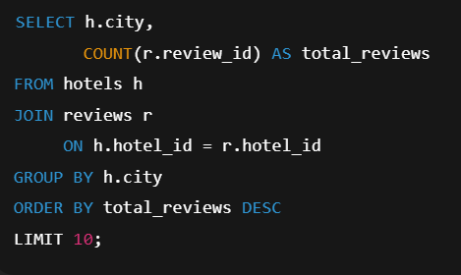
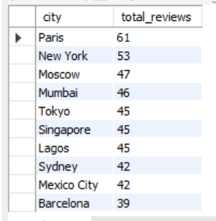
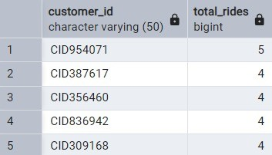
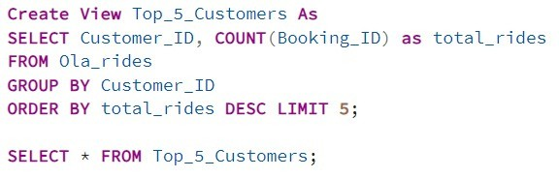
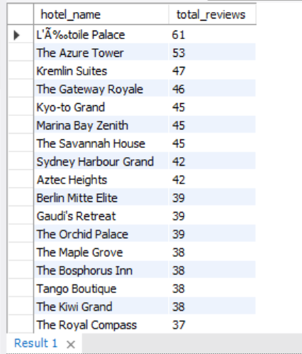
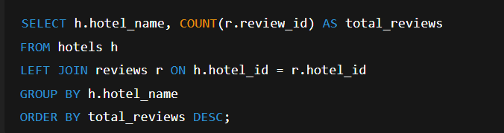

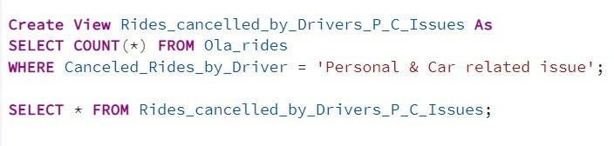
3. List the top 5 customers who booked the highest number of rides
Q3) Top 10 cities with most number of reviews
Q4) How many reviews each hotel has received.
4. Get the number of rides cancelled by drivers due to personal and car-related issues
By Vaibhav Bari

Slide 8
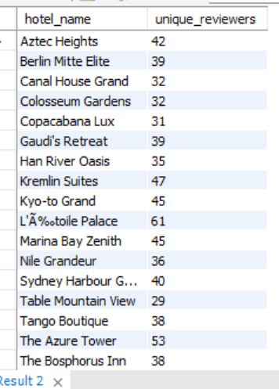
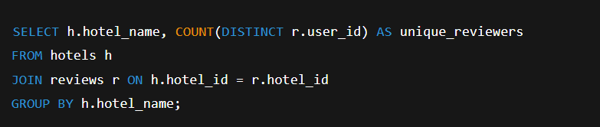
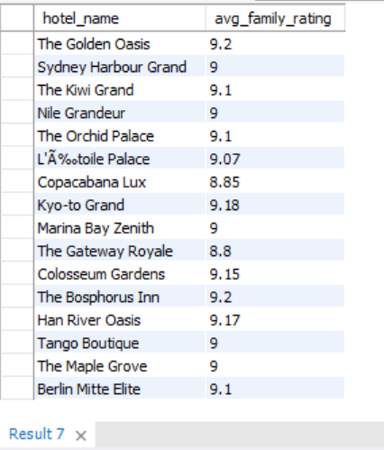
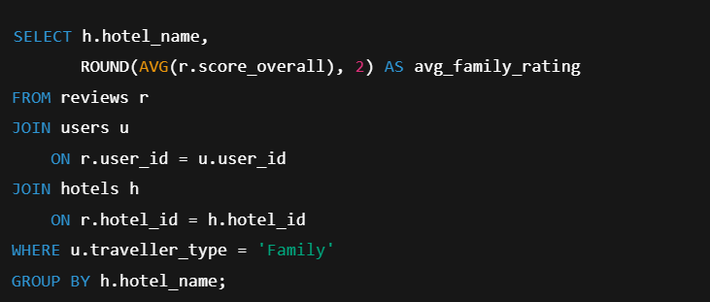
Q5) No of distinct users who reviewed each hotel.
Q6) Average rating given by travellers of type 'Family’ to each hotel.

Slide 9
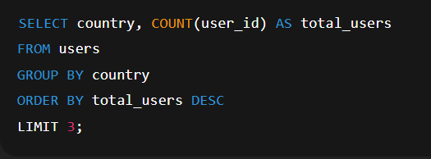
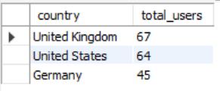
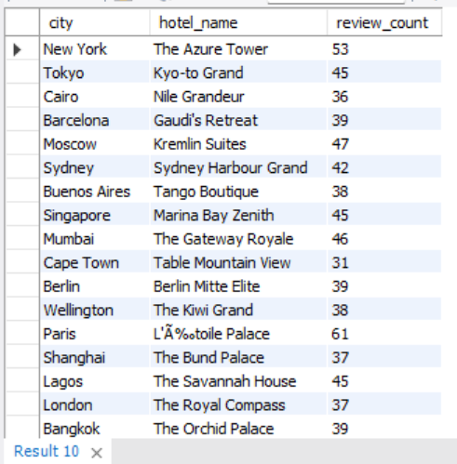
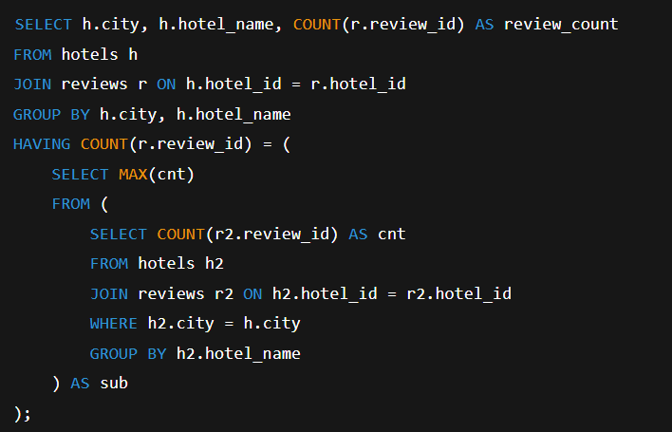
Q7)Top 3 countries with most registered users.
Q8) Most frequently reviewed hotel in each city .

Slide 10
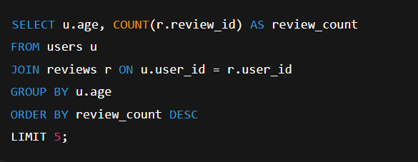
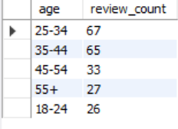
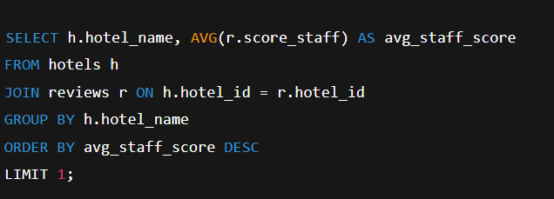
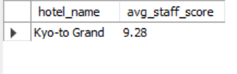
Q9) Top 5 most common age group of reviewers.
Q10) Hotel with highest average staff rating.

Slide 11
Dashboard Visuals

Slide 12
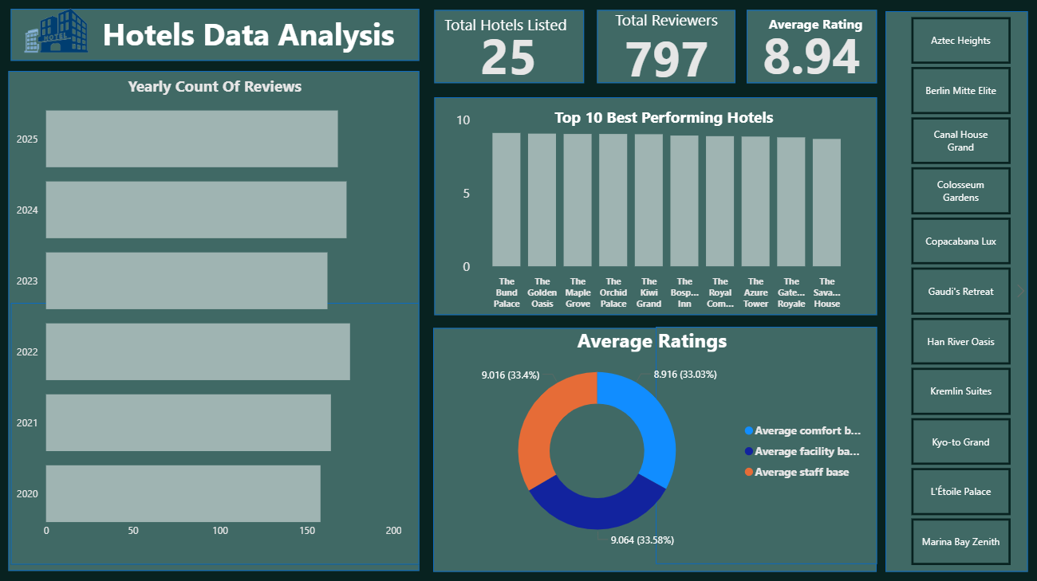

Slide 13

📊 Actionable Insights Summary
1.Overall Performance
Avg. overall hotel rating: 8.94 / 10 (strong customer satisfaction)
Top hotel: Canal House Grand (Netherlands) – 9.10 rating
2.Geographic Insights
Most hotels in: United States
Top-rated countries: Netherlands (9.10),
China (9.09),
Spain (9.05),
UAE (9.05),
South Korea (9.04)
Expand in high-rated markets with fewer properties
3.Customer Insights
Highest-rated traveler: Family (9.06)
Lowest-rated traveler: Business (8.80)
Enhance services for business travelers

Slide 14

Actionable Insights Summary
4.Category Performance
Strongest: Location (9.18), Cleanliness (9.04)
Weakest: Facilities (8.74), Value for Money (8.42)
Invest in improving amenities and pricing perception
5.User Growth (Last 6 Months)
Growth steady till July 2025, drop seen in Aug 2025
Run marketing or seasonal campaigns to sustain acquisition
6.Strategic Recommendations
Prioritize quality-focused markets (Netherlands, China)
Improve facility experience and value perception
Target business travelers with loyalty/corporate offers
Maintain consistent user acquisition through promotions

Slide 15

Thank You!!

